Slide 1



Wellness Morning

Slide 2
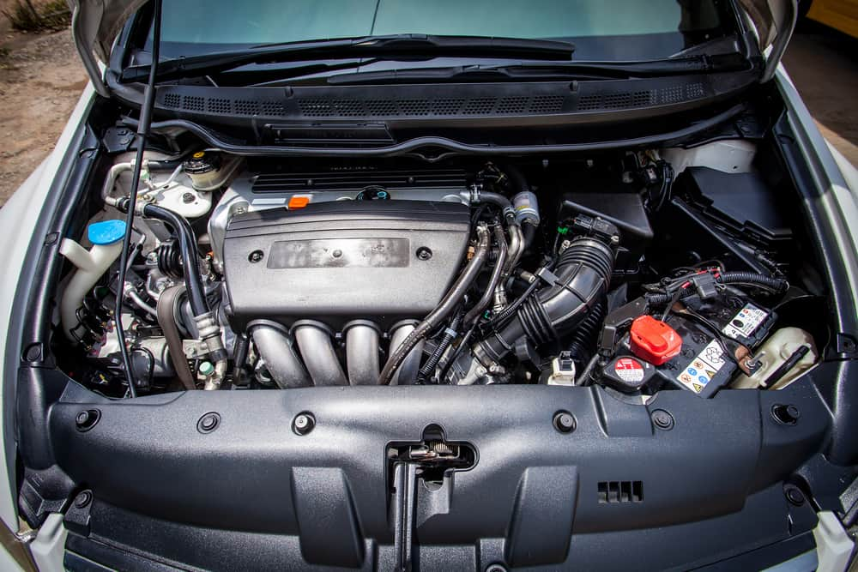
Car Engine

Slide 3
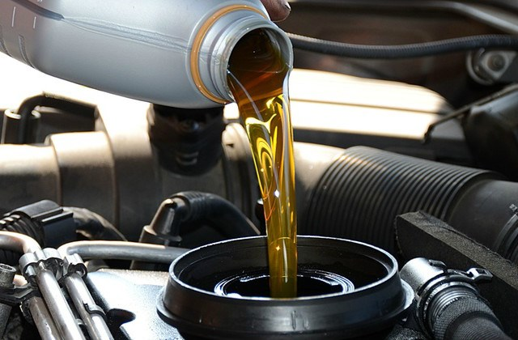
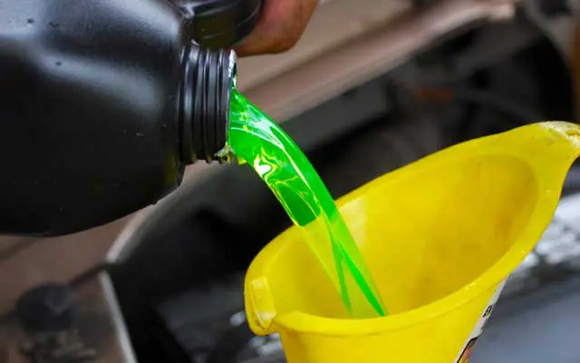

Oil - Coolant & Distribution

Slide 4
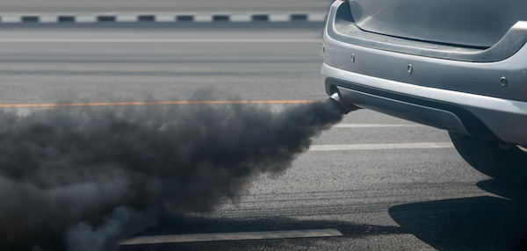
Car Exhaust

Slide 5
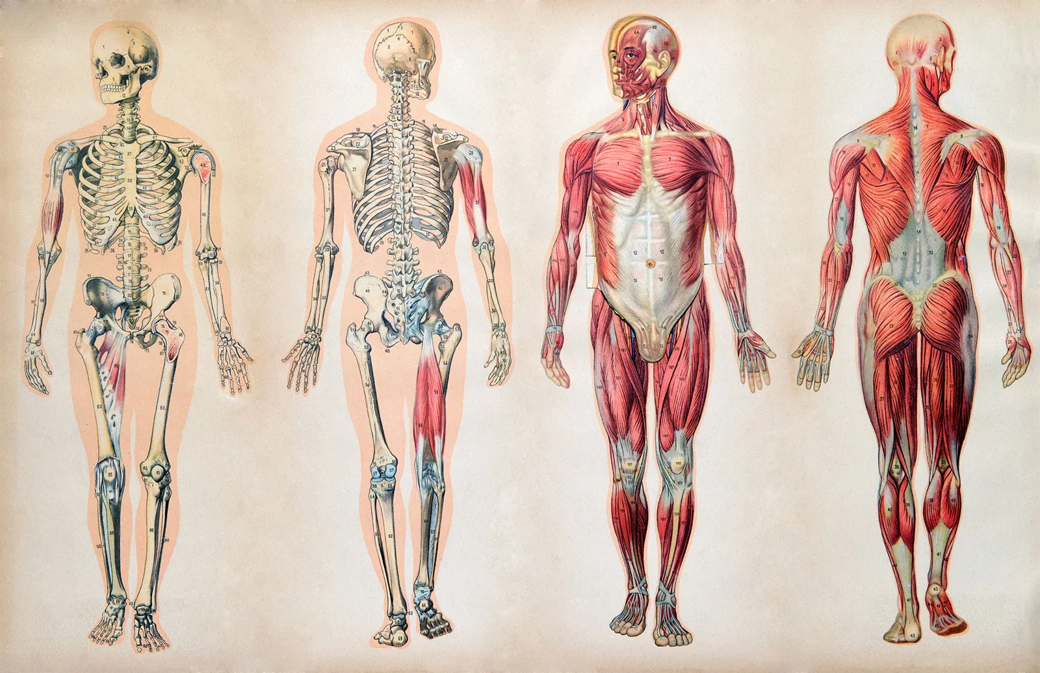

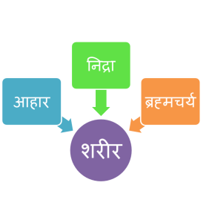

Slide 6




Slide 7


Slide 8



Slide 9



Slide 10



Slide 11


Self-discipline

Slide 12


Slide 13


Water & Oil

Slide 14

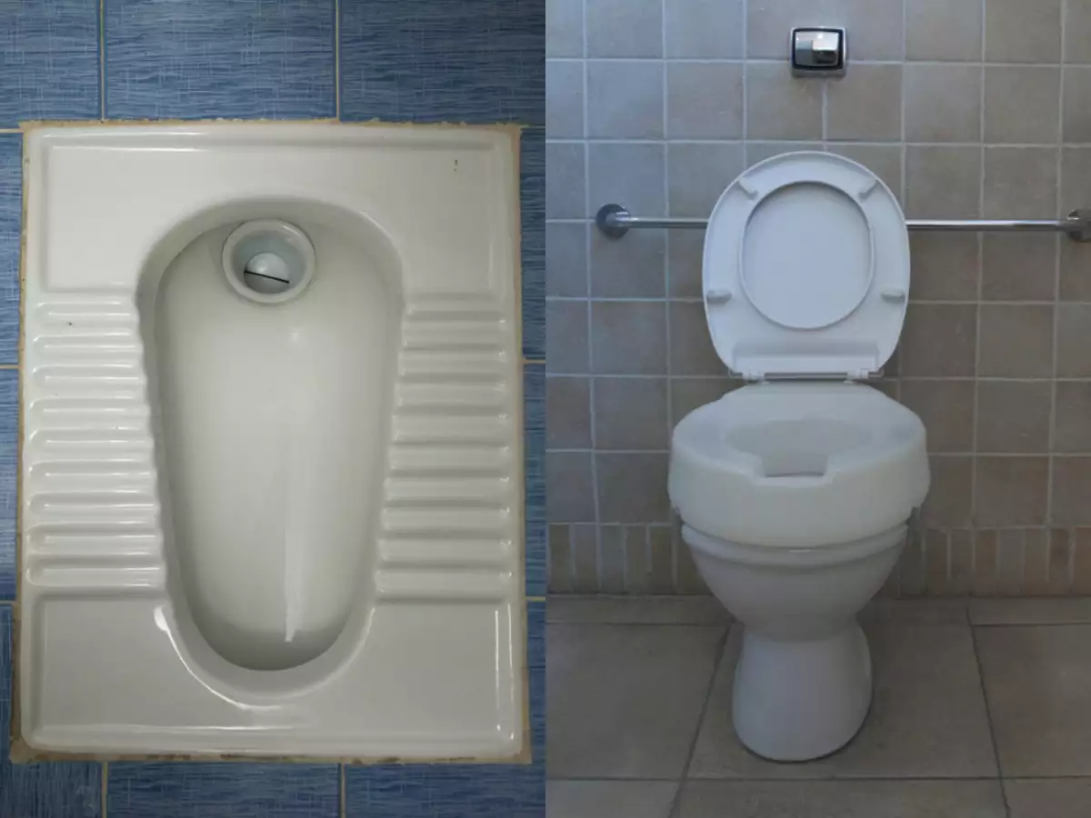

Slide 15


Heart & Brain

Slide 16
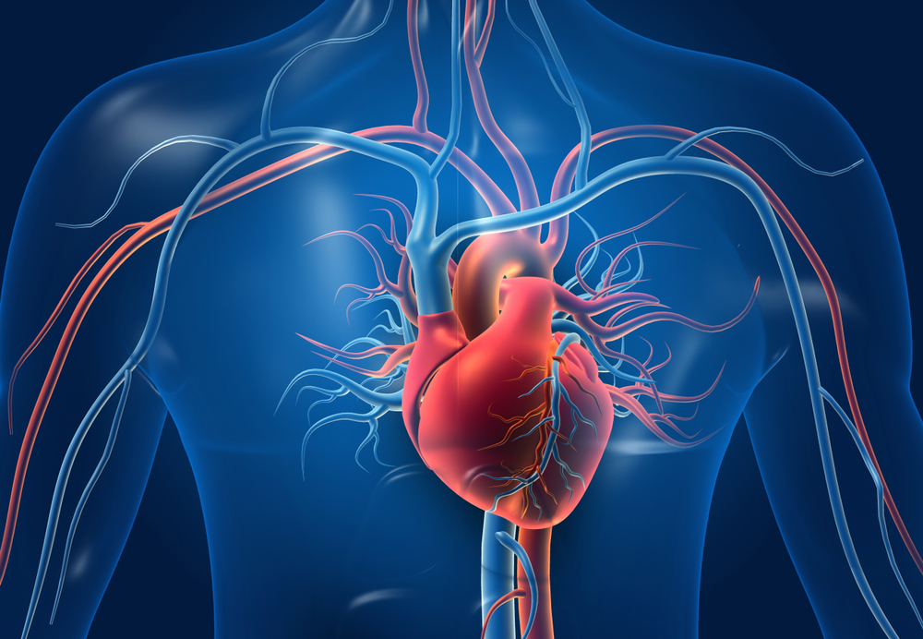
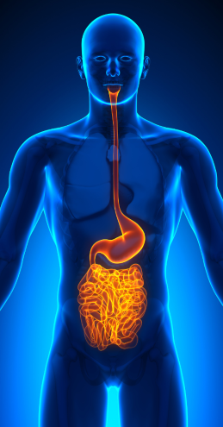


Slide 17



Slide 18






Slide 19


Slide 20
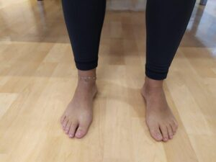
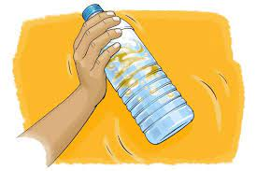

Slide 21



Slide 22


Slide 23
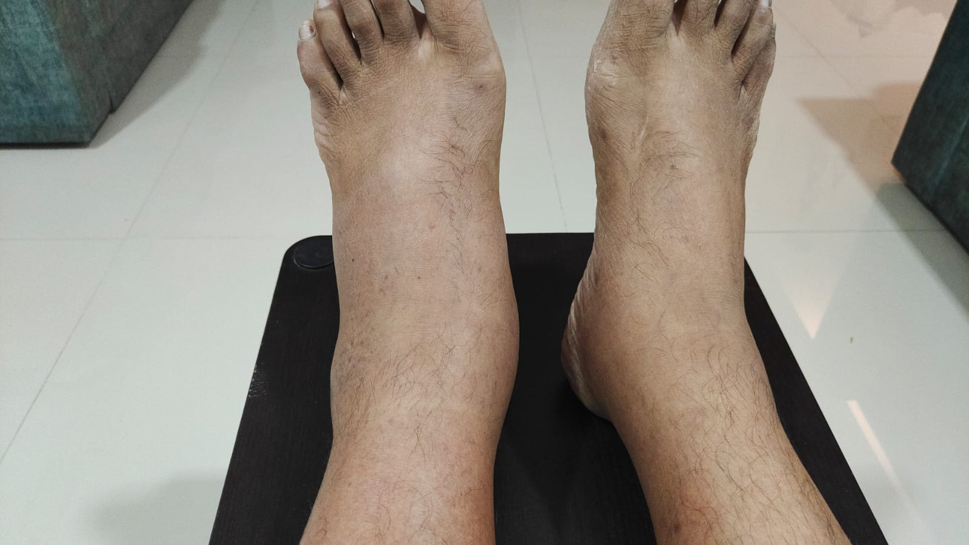
12th July

Slide 24

12th July

Slide 25


Slide 26
Wellness Morning
Foot Care
Self-Talk
Water & Oil
Shake & Smile
(Daily Supplements)
Read / Listen
Re-Set

Slide 27


